Slide 1
STRINGS

Slide 2
Strings
Definition
A string is an array of characters.
Any group of characters (except double quote sign) defined between double quotation marks is a constant string.
Character strings are often used to build meaningful and readable programs.
The common operations performed on strings are
Reading and writing strings
Combining strings together
Copying one string to another
Comparing a string with another
Extracting a portion of a string ..etc.

Slide 3
Declaration and initialization
char string_name[size];
The size determines the number of characters in the string_name.

Slide 5
Example

Slide 6
Reading Multiple Lines
We use third argument in cin.get() function
cin.get(array_name, max size, stop_char)
The argument stop_char specifies the character that tells the function to stop reading.
The default value for this argument is the newline (‘\n’) character, but if you call the function with some other character for this argument, the default will be overridden by the specified character.
If u provide more than max size those characters won’t be considered.

Slide 7
Example
#include <iostream>
using namespace std;
int main(){
const int len = 80; //max characters in string char str[MAX]; //string variable str
cout << "\nEnter a string:";
char str[len];
cin.get(str, len);
cout<<"\n"<<str;
return 0
}

Slide 8
Length of string
#include <iostream>
using namespace std;
int main(){
char a[30];
int i, c=0;
cout<<"Enter a string:";
cin.get(a,30);
for(i=0;a[i]!='\0';i++)
c++;
cout<<"\nLength of the string '"<<a<<"' is "<<c;
return 0;
}

Slide 9
String concatenation
#include<iostream>
using namespace std;
int main() {
char str1[55],str2[25];
int i=0,j=0;
cout<<"\nEnter First String:";
cin>>str1;
cout<<"\nEnter Second String:";
cin>>str2; while(str1[i]!='\0')
i++;
while(str2[j]!='\0')
{
str1[i]=str2[j];
j++;
i++;
}
str1[i]='\0';
cout<<"\nConcatenated String is\n"<<str1;
return 0;}

Slide 10
Insert substring
#include <iostream>
#include<string.h>
#include<math.h>
using namespace std;
int main()
{
char a[10], b[4], c[10];
int pos, len_a, len_b, t=0, i=0, p;
int x, tot_size, o;
cout<<"Enter First String:";
cin>>a;
cout<<"Enter Second String:";
cin>>b;
cout<<"Enter the position where the item has to be inserted: ";
cin>>p;
pos=p-1;
len_a=strlen(a);
len_b=strlen(b);
// Copying the input string into another array
while(i <=len_a)
{ // a value is copied to c
c[i]=a[i];
i++;
}
c[i]='\0';
tot_size = len_a+len_b;
o = pos+len_b; //making space for string b
// Adding the sub-string
for(i=pos;i<tot_size;i++)
{
x = c[i];
// remaining c[i] value is moved to a
a[o]=x; o=o+1;
if(t<len_b)
{ // substring b[t] is moved to a
a[i] = b[t];
t=t+1;
}
}
cout<<a; // a has the final result
return 0;
}

Slide 11
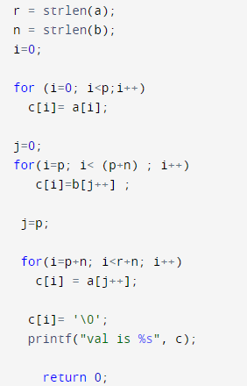

Slide 12
Delete substring
1. Take a string and its substring as input. 2. Put each word of the input string into the rows of 2-D array. 3. Search for the substring in the rows of 2-D array. 4. When the substring is got, then override the current row with next row and so on up to the last row.

Slide 13
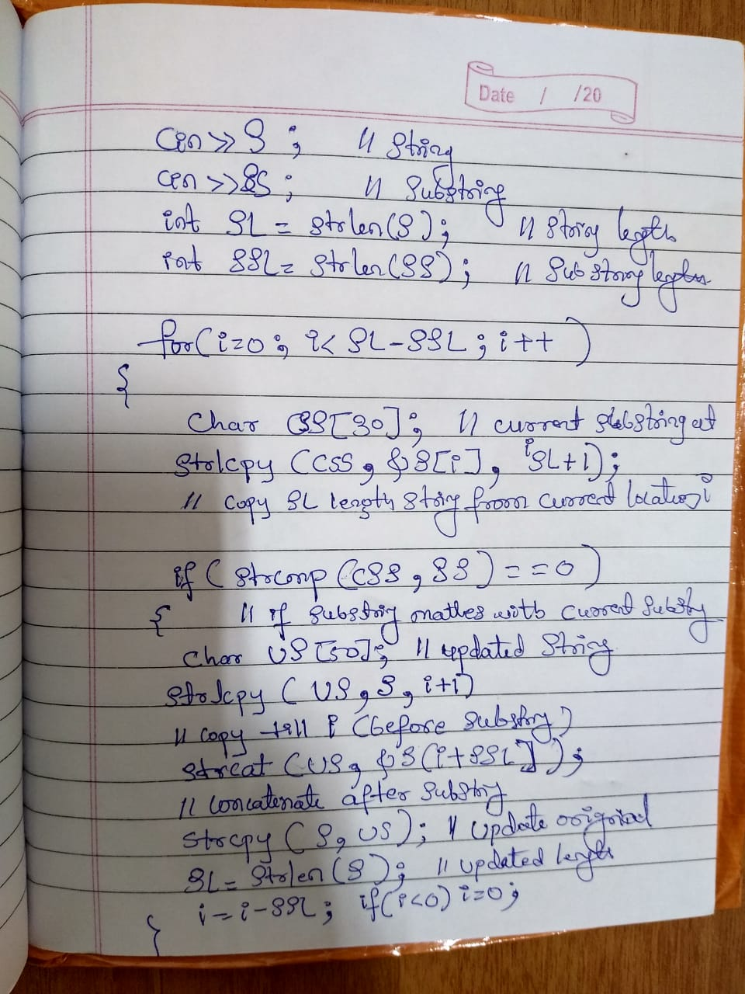
strlcpy() prototype
char* strnlpy( char* dest, const char* src, size_t count );
The strlcpy() function takes three arguments: dest, src and count. It copies a maximum of count characters from the string pointed to by src to the memory location pointed to by dest.

Slide 14
Library functions: String Handling functions(built-in)
These in‐built functions are used to manipulate a given string.
These functions are part of string.h header file.
strlen ()
gives the length of the string. E.g. strlen(string)
strcpy ()
copies one string to other. E.g. strcpy(Dstr1,Sstr2)
strcmp ()
compares the two strings. E.g. strcmp(str1,str2)
strcat ()
Concatinate the two strings. E.g. strcat(str1,str2)

Slide 15
Library function: strlen()
String length can be obtained by using the following function
n=strlen(string);
This function counts and returns the number of characters in a string, where n is an integer variable which receives the value of the length of the string. The argument may be a string constant.
Copying a String the Hard Way
The best way to understand the true nature of strings is to deal with them character by character. The following program copies one string to another character by character.

Slide 16
Copies a string using a for loop
#include <iostream>
#include<string.h>
using namespace std;
int main()
{
char str1[ ] = "Manipal Institute of Technology";
char str2[100];
int j;
for(j=0 ; j<strlen(str1); j++)
str2[j] = str1[j];
str2[j] = '\0';
cout << str1<<"\n"<<str2 << endl;
return 0;
}
7/13/2012
16

Slide 17
Copies a string using a for loop
The copying is done one character at a time, in the Statement str2[j] = str1[j];
The copied version of the string must be terminated with a null.
However, the string length returned by strlen() does not include the null.
We could copy one additional character, but it’s safer to insert the null explicitly. We do this with the line str2[j] = ‘\0’;
If you don’t insert this character, you’ll find that the string printed by the program includes all sorts of weird characters following the string you want.
The << just keeps on printing characters, whatever they are, until by chance it encounters a ‘\0’.

Slide 18
Library function: strcpy()
Copying a String the Easy Way
strcpy(destination, source)
The strcpy function works almost like a string assignment operator and assigns the contents of source to destination.
destination may be a character array variable or a string constant.
e.g., strcpy(city, “DELHI”);
will assign the string “DELHI” to the string variable city.
Similarly, the statement strcpy(city1, city2);
will assign the contents of the string variable city2 to the string variable city1.
The size of the array city1 should be large enough to receive the contents of city2.

Slide 19
strcpy(): Example
#include <iostream>
#include<string.h>
using namespace std;
int main()
{
char str1[ ] = "Manipal Institute of Technology";
char str2[100];
strcpy(str2,str1);
cout << str1<<"\n"<<str2 << endl;
return 0;
}

Slide 20
Library function: strcmp()
The strcmp function compares two strings identified by the arguments and has a value 0 if they are equal.
If they are not, it has the numeric difference between the first nonmatching characters in the strings.
strcmp(string1,string2);
string1 and string2 may be string variables or string constants.
e.g., strcmp(“their”, “there”); will return a value of –9 which is the numeric difference between ASCII ‘i’(105) and ASCII ‘r’(114). That is, ‘i’ minus ‘r’ w:r:to ASCII code is –9.
If the value is negative, string1 is alphabetically above string2.

Slide 21
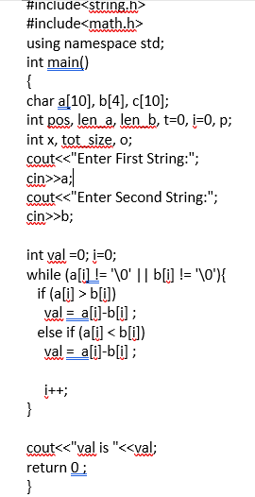

Slide 22
strcmp()
#include <iostream>
#include<string.h>
using namespace std;
int main()
{
char str1[ ] = "Manipal Institute of Technology";
char str2[ ] ="Manipal Institute of Technology";
if(strcmp(str1,str2)!=0)
cout<<"strings are not equal";
else
cout <<"Two strings are equal";
return 0;
}

Slide 23
Library function: strcat()
The strcat function joins two strings together.
It takes the following form:
strcat (string1, string2);
string1 and string2 are character arrays.
When the function strcat is excuted, string2 is appended to a string1.
It does so by removing the null character at the end of string1 and placing string2 from there.
The string at string2 remains unchanged.

Slide 24
strcat()
#include <iostream>
#include<string.h>
using namespace std;
int main()
{
char str1[ ] = "Manipal";
char str2[] =" Institute of Technology";
strcat(str1,str2);
cout<<"concatenated string is\n"<<str1;
return 0;
}

Slide 25
Reading integers and strings
#include <iostream>
using namespace std;
int main(){
int n;
char s1[10],s2[10];
cout<<"Enter integer";
cin>>n;
fflush(stdin);
gets(s1);
fflush(stdin);
gets(s2);
cout<<"s1="<<s1<<endl;
cout<<"s2="<<s2<<endl;
return 0;
}

Slide 26
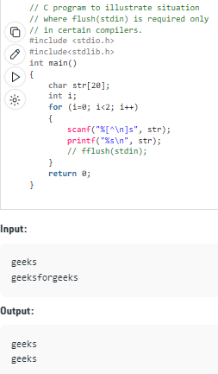
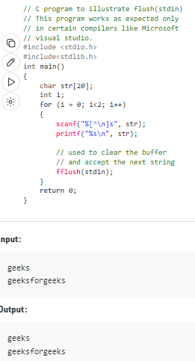
Notes:
The code above takes only single input and gives the same result for the second input. Reason is because as the string is already stored in the buffer i.e. stream is not cleared yet as it was expecting string with spaces or new line. So, to handle this situation fflush(stdin) is used.

Slide 27
Reading integers followed by multiline input strings
#include <iostream>
using namespace std;
int main(){
int n; char s1[10],s2[10];
cout<<"Enter integer";
cin>>n;
fflush(stdin);
cin.get(s1,10,'$');
fflush(stdin);
cin.get(s2,10,'$');
cout<<"s1="<<s1<<endl;
cout<<"s2="<<s2<<endl;
return 0;
}

